Slide 1
Figures Consideration
NP Paper
Cal Craven
09-16-20

Slide 2


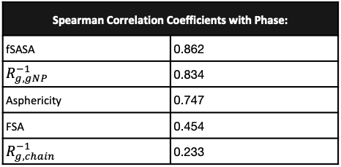
a).
b).
c).
Normalized Phase
fSASA
FSA
Asphericity
d).
e).
Phase
Dispersed Stringy Aggregated
Spearman Correlation Coefficients with Phase:
fSASA | 0.862
$R_{g,gNP}^{−1}$ | 0.834
Asphericity | 0.747
FSA | 0.454
$R_{g,chain}^{−1}$ | 0.233
Normalized Phase
$$R_{g,gNP}^{−1}$$
$$R_{g,chain}^{−1}$$

Slide 3
Current Version
Issues with Scale Bar

Slide 4
Other Heatmaps

Slide 5
Other Heatmaps

Slide 6
Normal Heat Map (Fixed Scale Bar)
N = 18 Carbons
ρ= 3.5 CH/nm²
FSA = 0.55
Dispersed
Dispersed
Dispersed
Chain Density (CH/nm²)
Chainlength (carbons)
Chainlength (carbons)
Stringy
Solvent Accessible Surface Area
Stringy
Stringy
Aggregated
Aggregated
a).
Fractional Surface Area
b).
Fractional Surface Area
c).
Chain Density (CH/nm²)

Slide 7
Phase Plots
N = 6 beads
ρ= 3.5 CH/nm²
FSA = 0.55
Dispersed
Stringy
Dispersed
Dispersed
Chain Density (CH/nm²)
Chainlength (beads)
Chainlength (beads)
Stringy
Stringy
Aggregated
Aggregated
a).
b).
c).
Chain Density (CH/nm²)
Fractional Surface Area
Fractional Surface Area

Slide 8
Gridded SASA Heatmaps
Solvent Accessible Surface Area

Slide 9
Gridded and Smoothed SASA Heatmaps
N = 6 beads
ρ= 3.5 CH/nm²
FSA = 0.55
Chain Density (CH/nm²)
Chainlength (beads)
Chainlength (beads)
Solvent Accessible Surface Area
a).
Fractional Surface Area
b).
Fractional Surface Area
c).
Chain Density (CH/nm²)

Slide 10
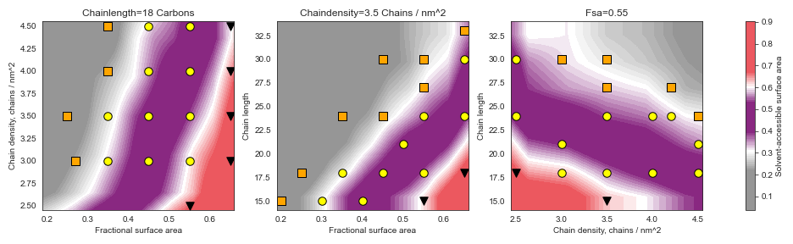
Gridded and Smoothed SASA Heatmaps
N = 18 Carbons
ρ= 3.5 CH/nm²
FSA = 0.55
Chain Density (CH/nm²)
Chainlength (carbons)
Chainlength (carbons)
Solvent Accessible Surface Area
a).
Fractional Surface Area
b).
Fractional Surface Area
c).
Chain Density (CH/nm²)

Slide 11
Gridded And Smoothed NP Rg
N = 18 Carbons
ρ= 3.5 CH/nm²
FSA = 0.55
Chain Density (CH/nm²)
Chainlength (carbons)
Chainlength (carbons)
NP Radius/Nanoparticle R_{g}
a).
Fractional Surface Area
b).
Fractional Surface Area
c).
Chain Density (CH/nm²)

Slide 12
Gridded And Smoothed Asphericity
N = 18 Carbons
ρ= 3.5 CH/nm²
FSA = 0.55
Chain Density (CH/nm²)
Chainlength (carbons)
Chainlength (carbons)
Asphericity
a).
Fractional Surface Area
b).
c).
Chain Density (CH/nm²)
Fractional Surface Area

Slide 13
Single Particle Terms W/out Core

Slide 14
Gridded with Heatmap (For SI)

Slide 15
Gridded with Heatmap (For SI)

Slide 16
Plain Phase Scatter Plots

Slide 17
Filled in Graft Rg
N = 18 Carbons
ρ= 3.5 CH/nm²
FSA = 0.55
Chain Density (CH/nm²)
Chainlength (carbons)
Chainlength (carbons)
NP Radius/Chain R_{g}
a).
Fractional Surface Area
b).
Fractional Surface Area
c).
Chain Density (CH/nm²)

Slide 18
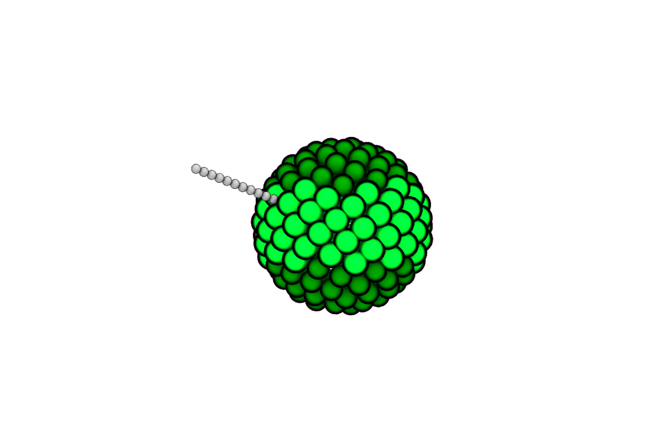
Alkane Terminus Bead
Alkane Chain Beads
Silica Core Beads

